Slide 1
Calendar+
Design
Authors: Chad Kinnard, Bo Yang Li, Tyler Marrapese, Warren Overstreet

Slide 2
Presentation Outline
Project Recap
Block Diagram
User Interface Diagram
Login & Registration
Monthly View
Weekly View
Daily View
Yearly View
Schedule View
Sidebars

Slide 3
Outline (continued…)
Entity Relationship Diagram (ERD)
Database
Component Diagram
Login/Register
Common.js
Day/Week/Month/Year/Schedule
Sidebar Events

Slide 4
Recap: What is Calendar+?
Calendar+ is a dynamic web application with which the user can create his/her own schedule.
Like any standard calendar web app, the user will be able to create events on any desired valid date.
Windows 10, Chrome browser

Slide 5
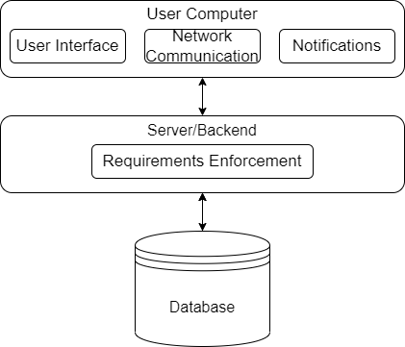
Block Diagram
Three-layer system
User Computer is the Presentation layer
Server layer is responsible for the business rules of the Calendar+ web application
Database is responsible for storing all user and account data

Slide 6
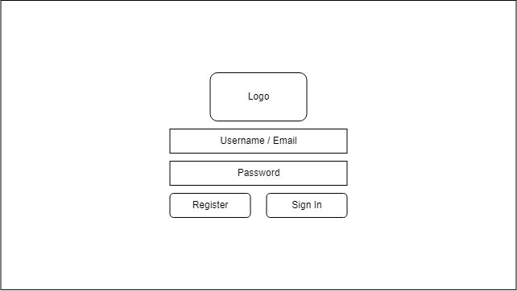
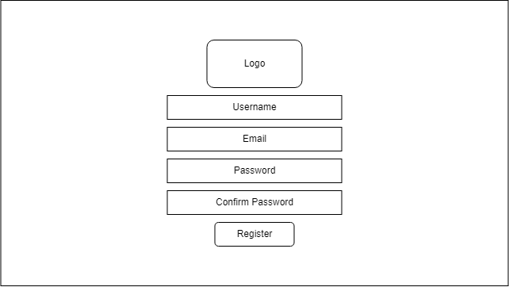
Login & Registration Pages

Slide 7
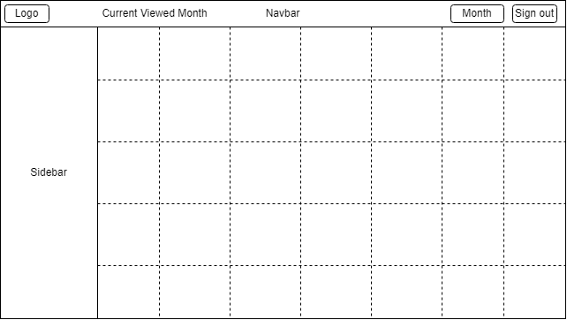
Month View Page
7x5 or 7x6 grid (depends on month)
At the top of each column is the week day
Each cell in grid contains:
Numbered day of month
If an event falls on that date:
A tile containing the title of that event

Slide 8
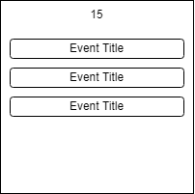
Month View Page
If multiple events fall on the same day:
Tiles will be presented in a list format, one on top of the other.

Slide 9
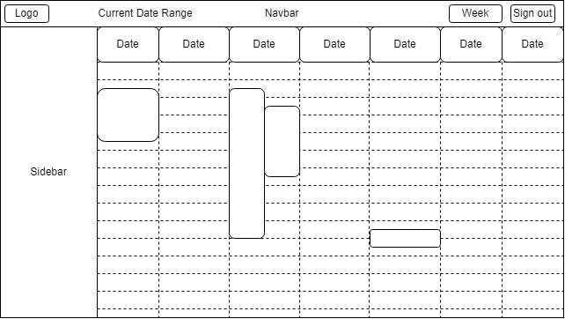
Week View Page
7x24 grid
At the top of each column is the week day
If an event falls on a date that is visible:
A tile containing the title and time of the event
Spans from the cell containing the start time to the cell containing the end time
If multiple, each tile occupies (100%*n) width of the column

Slide 10
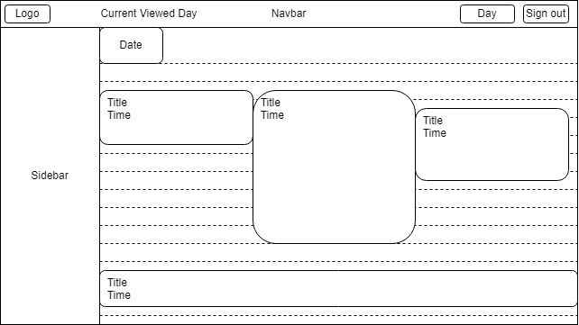
Day View Page
1x24 grid
Date at the top of the page
If an event falls on a date that is visible:
A tile containing the title and time of the event
Spans from the cell containing the start time to the cell containing the end time
If multiple, each tile occupies (100%*n) width of the column

Slide 11
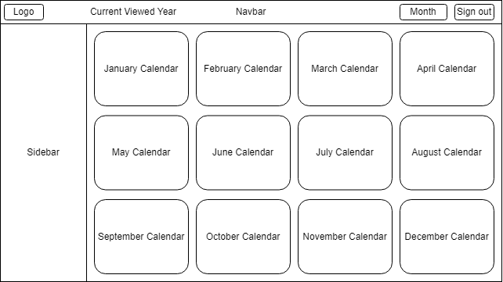
Year View Page
4x3 grid
Each cell in the grid contains:
Mini version of the month-view calendar for each month

Slide 12
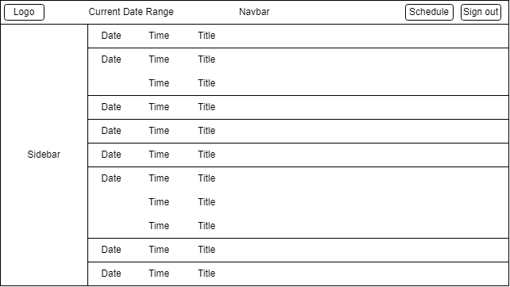
Schedule View Page
Tiles stacked vertically, only days which have an event.
Each tile contains the date, time, and title of the event.

Slide 13
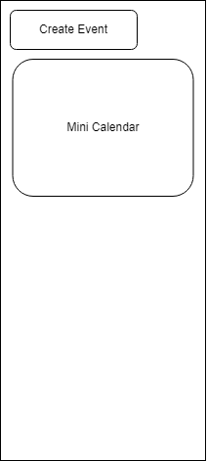
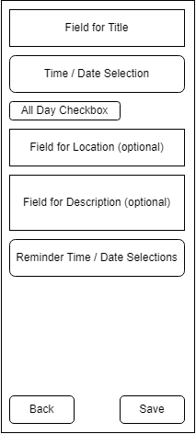
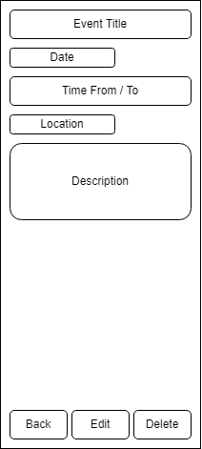
Sidebars

Slide 14
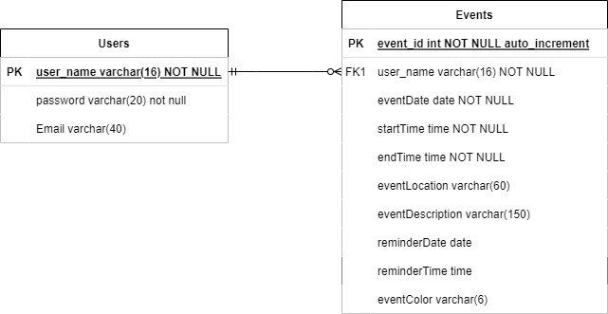
Database

Slide 15
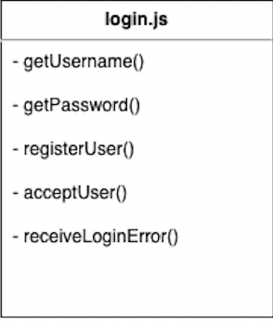
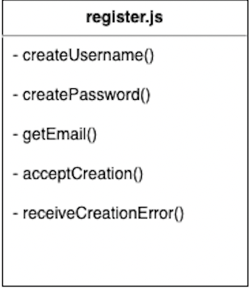
Components
Login / Register

Slide 16
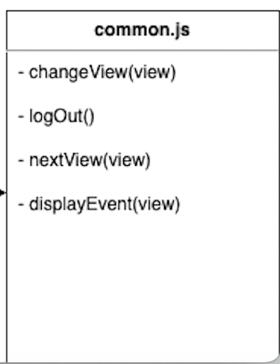
Components
Common

Slide 17
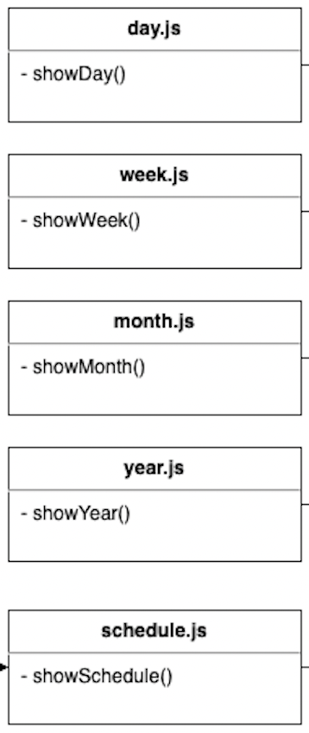
Components
Day / Week / Month / Year / Schedule

Slide 18
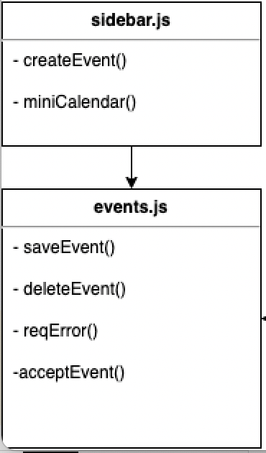
Components
Sidebar / Events

Slide 19
Summary
Overall, we described the underlying system supporting Calendar+ by going over our block diagram, ERD, UI diagrams, and our component diagram.
We described a layered architecture in our block diagram
We described how the frontend works in our UI diagrams
We described how our data is stored in the ERD
We described how our software components work in the component diagram
Thank You for listening to our presentation!
Any Questions?

Slide 20
The End

